Slide 1
Requirements Analysis and Specification
Prof. R. Mall
Dept. of CSE, IIT, Kharagpur

Slide 2
Requirements Analysis and Specification
Many projects have failed:
Because they started to implement the software.
Without ever determining whether they are building what the customer really wanted.

Slide 3
What are Requirements?
A Requirement is:
A capability or condition required from the system.
What is involved in requirements analysis and specification?
Determine what is expected by the client from the system.
Document them in the form that is clear to the client as well as to the development team members.

Slide 4
Understand and specifying requirements
A problem of scale:
For small scale: understanding and specifying requirements is easy
For large scale: very hard; probably the hardest, most problematic and error prone development task
The requirements specification task:
Input: User needs in minds of people (hopefully)!
Output: precise statement of what the future system will do

Slide 5
Requirements for Products
When a company plans to develop a generic product:
Who gives the requirements?
The sales personnel

Slide 6
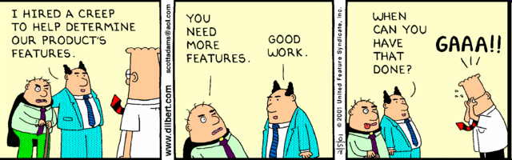
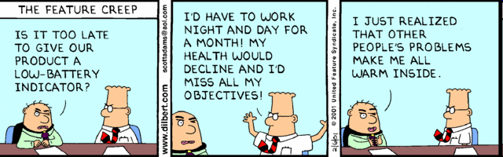
Dilbert: Scott Adams

Slide 7
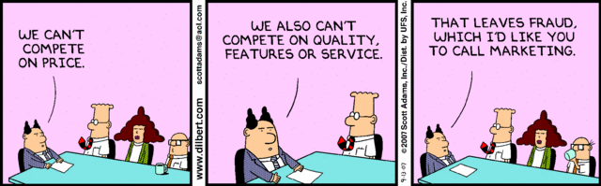
Dilbert: Scott Adams

Slide 8
Activities in Requirements Analysis and Specification
Requirements Gathering
Requirements Analysis
Requirements Specification

Slide 9
Requirements Engineering Process
Feasibility
Study
Requirements
gathering
Requirements
analysis
Feasibility
report
Requirements
specification
SRS Document

Slide 10
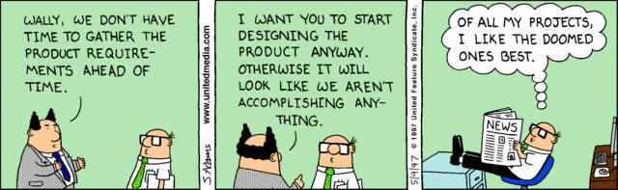
Dilbert: Scott Adams

Slide 11
Requirements Analysis and Specification
Requirements Gathering:
Fully understand the user requirements.
Requirements Analysis:
Remove inconsistencies, anomalies, etc. from requirements.
Requirements Specification:
Document requirements properly in an SRS document.

Slide 12
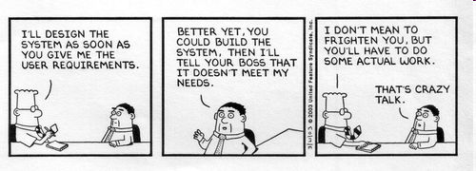
Dilbert: Scott Adams

Slide 13
Need for SRS…
Good SRS reduces development cost
Req. errors are expensive to fix later
Req. changes cost a lot (typically 40%)
Good SRS can minimize changes and errors
Substantial savings --- effort spent during req. saves multiple times that effort
An Example:
Cost of fixing errors in req. , design , coding , acceptance testing and operation are 2 , 5 , 15 , 50 , 150 person-months
Cost

Slide 14
Uses of SRS Document
Establish the basis for agreement between the customers and the suppliers
Provides starting point for development.
Provide a basis for estimating costs and schedules.
Provide a baseline for validation and verification.
Facilitates transfer.
Serves as a basis for enhancement.

Slide 15
Forms Basis for User Manual
The SRS can serve as the basis for writing User Manual for the software:
User Manual: Describes the functionality from the perspective of a user --- An important document for users.
Typically also describes how to carry out the required tasks with examples.

Slide 16
SRS Document: Stakeholders
SRS intended for a diverse audience:
Customers and users for validation, contract, ...
Systems (requirements) analysts
Developers, programmers to implement the system
Testers to check that the requirements have been met
Project Managers to measure and control the project
Different levels of detail and formality is needed for each audience
Different templates for requirements specifications:
Often variations of IEEE 830

Slide 17
Requirement process..
needs
Specification itself may lead to more analysis
Validation can show gaps that can lead to further analysis and specification .
Gathering
Analysis
Specification
Validation
SRS Document

Slide 18
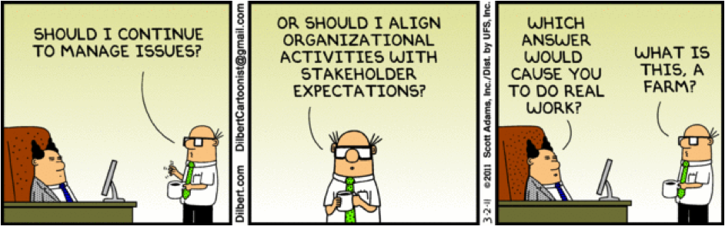
Dilbert: Scott Adams

Slide 19
How to Gather Requirements?
Observe existing (manual) systems,
Study existing procedures,
Discuss with customer and end-users,
Analyse what needs to be done
Input and Output analysis

Slide 20
Requirements Gathering Activities
1. Study existing documentation
2. Interview
3. Task analysis
4. Scenario analysis
5. Form analysis

Slide 21
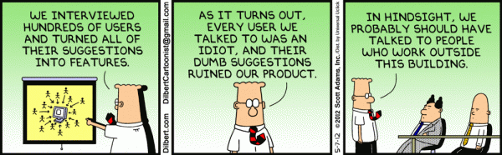
Dilbert: Scott Adams

Slide 22
Requirements Gathering (CONT.)
In the absence of a working system,
Lot of imagination and creativity are required.
Interacting with the customer to gather relevant data:
Requires a lot of experience.

Slide 23
Requirements Gathering (CONT.)
Some desirable attributes of a good system analyst:
Good interaction skills,
Imagination and creativity,
Experience…

Slide 24
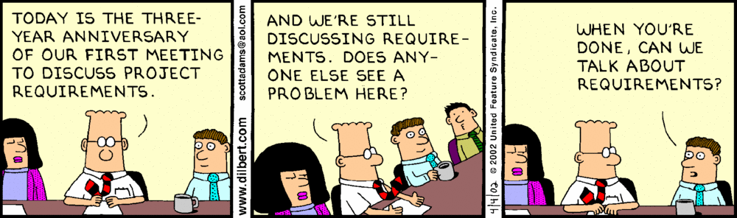
Dilbert: Scott Adams

Slide 25
Case Study: Automation of Office Work at CSE Dept.
The academic, inventory, and financial information at the CSE department:
Being carried though manual processing by two office clerks, a store keeper, and two attendants.
Considering the low budget he had at his disposal:
The HoD entrusted the work to a team of student volunteers.

Slide 26
Case Study: Automation of Office Work at CSE Dept.
The team was first briefed by the HoD:
Concerning the specific activities to be automated.
The analysts first discussed with the two office clerks:
Regarding their specific responsibilities (tasks) that were to be automated.
The analyst also interviewed student and faculty representatives who would also use the software.
Interview

Slide 27
Case Study: Automation of Office Work at CSE Dept.
For each task that a user needs the software to perform, they asked:
The steps through which these are to be performed.
The various scenarios that might arise for each task.
The analyst also collected the different types of forms that were being used.
Task and Scenario Analysis
Form Analysis

Slide 28
Case Study: Automation of Office Work at CSE Dept.
The analysts understood the requirements for the system from various user groups:
Identified inconsistencies, ambiguities, incompleteness.
Resolved the requirements problems through discussions with users:
Resolved a few issues which the users were unable to resolve through discussion with the HoD.
Documented the requirements in the form of an SRS document.
Requirements Analysis
Requirements Specification

Slide 29
Analysis of Gathered Requirements
Main purpose of req. analysis:
Clearly understand user requirements,
Detect inconsistencies, ambiguities, and incompleteness.
Incompleteness and inconsistencies:
Resolved through further discussions with the end-users and the customers.

Slide 30
Ambiguity
“All customers must have the same control field.”
Do you notice any problems?
Multiple interpretations possible
All customers have the same value in their control field.
All control fields have the same format.
One control field is issued for all customers.

Slide 31
Inconsistent Requirement
Some part of the requirement:
contradicts with some other part.
Example:
One customer says turn off heater and open water shower when temperature > 100°C
Another customer says turn off heater and turn ON cooler when temperature > 100°C

Slide 32
Incomplete Requirement
Some requirements not included:
Possibly due to oversight.
Example:
The analyst has not recorded: when temperature falls below 90° C
heater should be turned ON
water shower turned OFF.

Slide 33
Analysis of the Gathered Requirements (CONT.)
Requirements analysis involves:
Obtaining a clear, in-depth understanding of the software to be developed,
Remove all ambiguities and inconsistencies from the initial customer perception of the problem.

Slide 34
Analysis of the Gathered Requirements (CONT.)
It is quite difficult to obtain:
A clear, in-depth understanding of the problem:
Especially if there is no working model of the problem.

Slide 35
Analysis of the Gathered Requirements (CONT.)
Experienced analysts take considerable time:
Clearly understand the exact requirements the customer has in his mind.

Slide 36
Analysis of the Gathered Requirements (CONT.)
Experienced systems analysts know - often as a result of painful experiences ---
“Without a clear understanding of the problem, it is impossible to develop a satisfactory system.”

Slide 37
Analysis of the Gathered Requirements (CONT.)
Several things about the project should be clearly understood by the analyst:
What is the problem?
Why is it important to solve the problem?
What are the possible solutions to the problem?
What complexities might arise while solving the problem?

Slide 38
Analysis of the Gathered Requirements (CONT.)
Some anomalies and inconsistencies can be very subtle:
Escape even most experienced eyes.
If a formal model of the system is constructed,
Many of the subtle anomalies and inconsistencies get detected.

Slide 39
Analysis of the Gathered Requirements(CONT.)
After collecting all data regarding the system to be developed,
Remove all inconsistencies and anomalies from the requirements,
Systematically organize requirements into a Software Requirements Specification (SRS) document.

Slide 40
Software Requirements Specification
Main aim of requirements specification:
Systematically organize the requirements arrived during requirements analysis.
Document requirements properly.

Slide 41
SRS Document
As already pointed out--- useful in various contexts:
Statement of user needs
Contract document
Reference document
Definition for implementation

Slide 42
SRS Document (CONT.)
The SRS document is known as black-box specification:
The system is considered as a black box whose internal details are not known.
Only its visible external (i.e. input/output) behavior is documented.
Input Data
S
Output Data

Slide 43
SRS Document (CONT.)
SRS document concentrates on:
What needs to be done in terms of input-output behaviour
Carefully avoids the solution (“how to do”) aspects.

Slide 44
SRS Document (CONT.)
The requirements at this stage:
Written using end-user terminology.
If necessary:
Later a formal requirement specification may be developed from it.

Slide 45
Properties of a Good SRS Document
It should be concise
and at the same time should not be ambiguous.
It should specify what the system must do
and not say how to do it.
Easy to change.,
i.e. it should be well-structured.
It should be consistent.
It should be complete.

Slide 46
Properties of a Good SRS Document (cont...)
It should be traceable
You should be able to trace which part of the specification corresponds to which part of the design, code, etc and vice versa.
It should be verifiable
e.g. “system should be user friendly” is not verifiable

Slide 47
SRS should not include...
Project development plans
E.g. cost, staffing, schedules, methods, tools, etc
Lifetime of SRS is until the software is made obsolete
Lifetime of development plans is much shorter
Product assurance plans
Configuration Management, Verification & Validation, test plans, Quality Assurance, etc
Different audiences
Different lifetimes
Designs
Requirements and designs have different audiences
Analysis and design are different areas of expertise

Slide 48
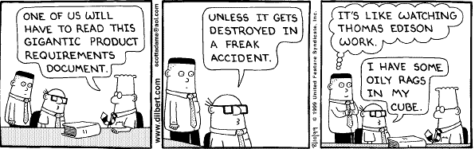
A Badly Written Gigantic Document is a Pain to Users
Dilbert: Scott Adams

Slide 49
SRS Document (CONT.)
Following are possibly the most important parts:
Functional requirements,
External Interfaces
Non-functional requirements,
Constraints

Slide 50
Functional Requirements
Specifies all the functionality that the system should support
Heart of the SRS document:
Forms the bulk of the Document
Outputs for the given inputs and the relationship between them
Must specify behavior for invalid inputs too!

Slide 51
Functional Requirement Documentation
Overview
describe purpose of the function and the approaches and techniques employed
Inputs and Outputs
sources of inputs and destination of outputs
quantities, units of measure, ranges of valid inputs and outputs
timing

Slide 52
Functional Requirement Documentation
Processing
validation of input data
exact sequence of operations
responses to abnormal situations
any methods (eg. equations, algorithms) to be used to transform inputs to outputs

Slide 53
Nonfunctional Requirements
Characteristics of the system which can not be expressed as functions:
Maintainability,
Portability,
Usability,
Security,
Safety, etc.

Slide 54
Nonfunctional Requirements
Reliability issues
Performance issues:
Example: How fast the system can produce results
so that it does not overload another system to which it supplies data, etc.
Needs to be measurable (verifiability)
Eg resp time should be xx 90% of the time

Slide 55
Constraints
Hardware to be used,
Operating system
or DBMS to be used
Capabilities of I/O devices
Standards compliance
Data representations
by the interfaced system

Slide 56
External Interface Requirements
User interfaces
Hardware interfaces
Software interfaces
Communications interfaces with other systems
File export formats

Slide 57
Goals of Implementation
Goals describe things that are desirable of the system:
But, would not be checked for compliance.
For example,
Reusability issues
Functionalities to be developed in future

Slide 58
IEEE 830-1998 Standard for SRS
Title
Table of Contents
1. Introduction
1.1 Purpose
1.2 Scope
1.3 Definitions. Acronyms, and Abbreviations
1.4 References
1.5 Overview
2. Overall Description
3. Specific Requirements
Appendices
Index
Describe purpose of this SRS
Describe intended audience
Identify the software product
Enumerate what the system will and will not do
Describe user classes and benefits for each
Define the vocabulary of the SRS (may reference appendix)
List all referenced documents including sources (e.g., Use Case Model and Problem Statement; Experts in the field)
Describe the content of the rest of the SRS
Describe how the SRS is organized

Slide 59
IEEE 830-1998 Standard – Section 2 of SRS
Title
Table of Contents
1. Introduction
2. Overall Description
2.1 Product Perspective
2.2 Product Functions
2.3 User Characteristics
2.4 Constraints
2.5 Assumptions and Dependencies
3. Specific Requirements
4. Appendices
5. Index
Present the business case and operational concept of the system
Describe how the proposed system fits into the business context
Describe external interfaces: system, user, hardware, software, communication
Describe constraints: memory, operational, site adaptation
Summarize the major functional capabilities
Include the Use Case Diagram and supporting narrative (identify actors and use cases)
Include Data Flow Diagram if appropriate
Describe and justify technical skills and capabilities of each user class
Describe other constraints that will limit developer’s options; e.g., regulatory policies; target platform, database, network software and protocols, development standards requirements

Slide 60
IEEE 830-1998 Standard – Section 3 of SRS (1)
…
1. Introduction
2. Overall Description
3. Specific Requirements
3.1 External Interfaces
3.2 Functions
3.3 Performance Requirements
3.4 Logical Database Requirements
3.5 Design Constraints
3.6 Software System Quality Attributes
3.7 Object Oriented Models
4. Appendices
5. Index
Specify software requirements in sufficient detail to enable designers to design a system to satisfy those requirements and testers to verify requirements
State requirements that are externally perceivable by users, operators, or externally connected systems
Requirements should include, at a minimum, a description of every input (stimulus) into the system, every output (response) from the system, and all functions performed by the system in response to an input or in support of an output
(a) Requirements should have characteristics of
high quality requirements (b) Requirements should be cross-referenced to
their source. (c) Requirements should be uniquely identifiable (d) Requirements should be organized to
maximize readability

Slide 61
IEEE 830-1998 Standard – Section 3 of SRS (2)
…
1. Introduction
2. Overall Description
3. Specific Requirements
3.1 External Interfaces
3.2 Functions
3.3 Performance Requirements
3.4 Logical Database Requirements
3.5 Design Constraints
3.6 Software System Quality Attributes
3.7 Object Oriented Models
4. Appendices
5. Index
Detail all inputs and outputs (complement, not duplicate, information presented in section 2)
Examples: GUI screens, file formats
Include detailed specifications of each use case, including collaboration and other diagrams useful for this purpose
Include:
Types of information used
Data entities and their relationships
Should include:
Standards compliance
Accounting & Auditing procedures
The main body of requirements organized in a variety of possible ways:
Architecture Specification
Class Diagram
State and Collaboration Diagrams
Activity Diagram (concurrent/distributed)‏

Slide 62
IEEE 830-1998 Standard – Templates
Section 3 (Specific Requirements) may be organized in many different ways based on
Modes
User classes
Concepts (object/class)
Features
Stimuli
Organizations

Slide 63
SRS explained
1.0 INTRODUCTION
This document specifies all the requirements for
1.1 Purpose
The purpose of the …is to ….
The system should assist ….
The intended audience for this document is …
This specification describes …..
1.2 Scope
This document applies only to …...
This specification is not concerned with …..

Slide 64
SRS explained
2.0 GENERAL DESCRIPTION
2.1 Product Perspective
This system allows stakeholders to…..
The system will display…..
The system will help ……
The system provides information about ….
2.2 Product Functions
The system provides the following functions:

Slide 65
SRS explained
2.3 User Characteristics
The users of the system are:
Level of Users’ Computer Knowledge
Level of Users’ Business Knowledge
Frequency of Use
2.4 General Constraints
The system will support ….
The system will not allow ……
2.5 Assumption and Dependencies
This system relies on ……
The system must have a satisfactory interface and ……
‹#›

Slide 66
Section 3 of SRS
SPECIFIC REQUIREMENTS 3.1 Functional Requirements 3.1.1 Subject Registration
The subject registration requirements are concerned with functions regarding subject registration which includes students selecting, adding, dropping, and changing a subject.
F-001 (3.1.1.1):
The system shall allow the user to register a subject.
F-002 (3.1.1.2):
ARS shall allow the user to delete a subject if the user has chosen to drop that unit.
F-003 (3.1.1.3):
ARS shall check if a unit has been filled by enough registered students.

Slide 67
SRS functional Reqs
F-004 (3.1.1.4):
ARS shall allow the user to add his/her name to the unit waiting list if the user wants to register in a subject which has been filled already with enough registered students.
F-005 (3.1.1.5):
ARS shall automatically register the subject for the user who is the first one on the waiting list if a vacancy appears for that subject.
F-006 (3.1.1.6):
ARS shall allow the user to change practical session(s), if available.
‹#›

Slide 68
Design Constraints (3.2)
3.2 Design Constraints
C-001 (3.2.1):
ARS shall provide user interface through standard web browsers.
C-002 (3.2.2):
ARS shall support PC and/or UNIX platforms.
C-003 (3.2.3):
ARS shall be developed using the JAVA programming language
‹#›

Slide 69
Non-functional requirements
3.3 Non-Functional Requirements
N-001 (3.3.1):
ARS shall respond to any retrieval in less than 5 seconds.
N-002 (3.3.2):
ARS shall generate a report within 1 minute.
N-003 (3.3.3):
ARS shall allow the user to remotely connect to the system.
N-004 (3.3.8):
The system will be accompanied by a well-written user manual.

Slide 70
Structure of an SRS
Introduction
Purpose , the basic objective of the system
Scope of what the system is to do , not to do
Overall description
Product perspective
Product functions
User characteristics
Assumptions
Constraints

Slide 71
Structure of an SRS…
Specific requirements
External interfaces
Functional requirements
Performance requirements
Design constraints
Acceptance criteria
desirable to specify this up front.
Based on IEEE 830.

Slide 72
Partitioning
Partitioning decomposes a problem and Establishes a hierarchical representation of information (or function):
- exposing increasing detail by moving vertically in the hierarchy
- decomposing the problem by moving horizontally in the hierarchy.
SafeHome Software
Configure system
Monitor sensors
Interact with user
Poll for sensor event
Activate alarm functions
Activate audible alarm
Dial phone number

Slide 73
Functional Requirements
It is desirable to consider every system as:
Performing a set of functions {fi}.
Each function fi considered as:
Transforming a set of input data to corresponding output data.
Input Data
Output Data
fi

Slide 74
Example: Functional Requirement
F1: Search Book
Input:
an author’s name:
Output:
details of the author’s books and the locations of these books in the library.
Author Name
Book Details
f1

Slide 75
Functional Requirements
Functional requirements describe:
A set of high-level requirements
Each high-level requirement:
takes in some data from the user
outputs some data to the user
Each high-level requirement:
might consist of a set of identifiable functions

Slide 76
Functional Requirements
For each high-level requirement:
A function is described in terms of:
Input data set
Output data set
Processing required to obtain the output data set from the input data set.

Slide 77
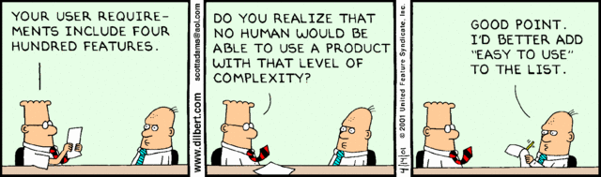
Dilbert: Scott Adams

Slide 78
Functional Requirements
A high-level function is one:
Using which the user can get some useful piece of work done.
Can the receipt printing work during withdrawal of money from an ATM:
Be called a high level function?
A high-level requirement typically involves:
Accepting some data from the user,
Transforming it to the required response, and then
Outputting the system response to the user.

Slide 79
Use Cases
A use case is a term in UML:
Represents a high level functional requirement.
Use case representation is more well-defined and has agreed documentation:
Compared to a high-level functional requirement and its documentation
Therefore many organizations document the functional requirements in terms of use cases

Slide 80
Example Functional Requirements
Req. 1:
Once user selects the “search” option,
he is asked to enter the key words.
The system should output details of all books
whose title or author name matches any of the key words entered.
Details include: Title, Author Name, Publisher name, Year of Publication, ISBN Number, Catalog Number, Location in the Library.

Slide 81
Example Functional Requirements
Req. 2:
When the “renew” option is selected,
The user is asked to enter his membership number and password.
After password validation,
The list of the books borrowed by him are displayed.
The user can renew any of the books:
By clicking in the corresponding renew box.

Slide 82
High-Level Function: A Closer View
A high-level function:
Usually involves a series of interactions between the system and one or more users.
Even for the same high-level function,
There can be different interaction sequences (or scenarios)
Due to users selecting different options or entering different data items.

Slide 83
Req. 1:
R.1.1:
Input: “search” option,
Output: user prompted to enter the key words.
R1.2:
Input: key words
Output: Details of all books whose title or author name matches any of the key words.
Details include: Title, Author Name, Publisher name, Year of Publication, ISBN Number, Catalog Number, Location in the Library.
Processing: Search the book list for the keywords

Slide 84
Req. 2:
R2.1:
Input: “renew” option selected,
Output: user prompted to enter his membership number and password.
R2.2:
Input: membership number and password
Output:
list of the books borrowed by user are displayed. User prompted to enter books to be renewed or
user informed about bad password
Processing: Password validation, search books issued to the user from borrower list and display.

Slide 85
Req. 2:
R2.3:
Input: user choice for renewal of the books issued to him through mouse clicks in the corresponding renew box.
Output: Confirmation of the books renewed
Processing: Renew the books selected by the in the borrower list.

Slide 86
Examples of Bad SRS Documents
Unstructured Specifications:
Narrative essay --- one of the worst types of specification document:
Difficult to change,
Difficult to be precise,
Difficult to be unambiguous,
Scope for contradictions, etc.

Slide 87
Examples of Bad SRS Documents
Noise:
Presence of text containing information irrelevant to the problem.
Silence:
Aspects important to proper solution of the problem are omitted.

Slide 88
Examples of Bad SRS Documents
Overspecification:
Addressing “how to” aspects
For example, “Library member names should be stored in a sorted descending order”
Overspecification restricts the solution space for the designer.
Contradictions:
Contradictions might arise
if the same thing described at several places in different ways.

Slide 89
Examples of Bad SRS Documents
Ambiguity:
Literary expressions
Unquantifiable aspects, e.g. “good user interface”
Forward References:
References to aspects of problem
defined only later on in the text.
Wishful Thinking:
Descriptions of aspects
for which realistic solutions will be hard to find.

Slide 90
Suggestions for Writing Quality Requirements
Keep sentences and paragraphs short.
Use active voice.
Use proper grammar, spelling, and punctuation.
Use terms consistently and define them in a glossary.
To see if a requirement statement is sufficiently well defined,
Read it from the developer’s perspective

Slide 91
Suggestions for Writing Quality Requirements cont…
Avoid stating requirements redundantly in the SRS.
Including the same requirement in multiple places may make the document easier to read,
But, it makes the document more difficult to maintain.
The multiple instances of the requirement all have to be updated at the same time,
Lest an inconsistency would creep in.

Slide 92
Suggestions for Writing Quality Requirements
Split a requirement into multiple sub-requirements:
Because each will require separate test cases and because each should be separately traceable.
If several requirements are strung together in a paragraph, it is easy to overlook one during construction or testing.

Slide 93
Reviewing Requirements for Quality: An Example
The product shall provide status messages at regular intervals not less than every 60 seconds.
What is wrong with this requirement?
This requirement is incomplete:
What are the status messages and how are they supposed to be displayed to the user?
The requirement contains ambiguities.
Is the interval between status messages really supposed to be at least 60 seconds, so showing a new message every 10 years is okay?

Slide 94
A Better Requirement
1. Status Messages.
1.1. The Background Task Manager shall display status messages in a designated area of the user interface at intervals of 60 plus or minus 10 seconds.
1.2. If background task processing is progressing normally, the percentage of the background task processing that has been completed shall be displayed.
1.3. A message shall be displayed when the background task is completed.
1.4. An error message shall be displayed if the background task has stalled.

Slide 95
SRS Review
Review done by the Developers along with the user representatives.
To verify that SRS confirms to the actual user requirements
To detect defects early and correct them.
Review typically done using standard inspection process:
Checklists.

Slide 96
A Sample SRS Checklist
Have response times been specified for functions ?
Have all the HW, external SW and data interfaces been defined ?
Is each requirement testable ?
Is the initial state of the system defined ?
Are the responses to exceptional conditions specified ?

Slide 97
What is the difference between a System Specification and a Software Specification?
System specification concerns full functionality of the system.
Some of the functionalities may be performed in hardware and some in software.
Example, if the system is required to move an object to a particular position within an accuracy of ± 1 millimeter:
This requirement would be met partly by each of mechanical hardware, servo amplifier and electronics, and the software.

Slide 98
System Specification
System specification needs to address the following issues:
Define the functions of the system
Define the Hardware / Software Functional Partitioning
Define the Performance Specification
Define the Hardware / Software Performance Partitioning
Define Safety Requirements
Define the User Interface
Develop Installation Drawings/Instructions.

Slide 99
Video Rental Store Software
A video rental store has a large collection of video CDs and DVDs in VHS and MP4 format as well as music CDs.
A person can become member a member by depositing Rs. 1000 and filling up details such as name, address, and telephone number. A member can cancel his membership and take back his deposit, if he has no dues outstanding against him.
Whenever the store purchases a new item, details such as price and date of procurement are entered. The daily rental charge is also entered by the manager. After passage of a year, the daily rental charge is automatically halved.
A member can, at a time, take on loan at most two video CDs and one music CD. The details are entered by a store clerk and a receipt indicating the daily rental charge should be printed by the software.
Whenever a member returns his loaned item(s), the due amount to be paid is displayed. After the amount is paid, the items are marked returned.
If a customer loses or damages any item, the full price of the item is charged to him and the item is removed from the inventory.
If an item is not lent out by anyone for even once over a year, the item is sold at 10% of the purchase price and is removed from the inventory.
The manager can, at any time, check the profit/loss account.

Slide 100
IIT Security Software
The staff and students of IIT register their vehicle by filling up a form which a security staff would enter into the system.
Each time a vehicle enters or leaves the campus, a camera reads the registration number of the car, and the model of the car. If the car is registered, the check gate should lift automatically to let in (or out) the vehicle. The details regarding the entry and exit of the vehicle are registered in the database. For outside vehicles, the driver needs to enter the purpose of entry, the model number, the registration number, and a photograph of the vehicle is stored in the database.
When an outside vehicle leaves the campus, the details are automatically registered in the database. For any external vehicle that is inside the campus for more than 8 hours, the driver is stopped by the security personnel manning the gate, queried to satisfaction, and the response are recorded. Considering that there have been several incidence of speeding and rough driving, the security personnel are empowered to telephone the registration number of errant vehicles to the main gate. For outside vehicles, the driver is quizzed at the check gate and his future entry is barred if the response is not satisfactory. For inside vehicles, a letter is issued to the dean to deal with the employee or student as the case might be.
The security officer can check the data regarding the number of vehicles going in and coming out of the campus (over a day, month or year), the total number of vehicles currently inside the campus.

Slide 101
Personal Library System
The software is required to manage the collection of books by individuals.
A person can have a few hundreds of books. The details of all the books such as name of the book, year of publication, date of purchase, price, and publisher must be entered. A book is to be given a unique serial number by the computer which would be written by the owner using a pen on the book. Before a friend can be lent a book, he must be registered. The registration data would include name of the friend, address, land line number, and mobile number. Before a friend is issued a book, the various books outstanding against him also with the date borrowed are displayed. The date of issue and the title of the book are stored. When a friend returns a book, the date of return is stored and the book is removed from his borrowing list. Up on query, the software should display the name, address, and telephone numbers of each friend against whom books are outstanding along with the titles of the outstanding books and the date on which those were issued.
The owner of the library software, when he borrows books from his friends, would enter the details regarding the title of books borrowed, and the date borrowed. Similarly, the return details of books would be entered. The software should be able display all the books borrowed from various friends. The owner should be able to query about the availability of a particular book, the total number of books in the personal library,

Slide 102
Travel Agency Automation Software
The company owns a number of vehicles (cars and SUVs) of various make and intends to deploy a web-based software. A customer can become regular customer by depositing Rs. 5,000/-.
When a customer requests for a car, he is displayed the types of vehicles are available, and their charges. For every vehicle, there is a per hour charge, and a per kilometer charge. A vehicle can be rented for a minimum of 4 hours. An AC vehicle of a particular category is charged 50% more than a non-AC vehicle of the same category. There is a charge of Rs 300 for every night of halt regardless of the type of the vehicle.
A customer can book a vehicle, only if he has at least Rs. 2000/- advance. The customer needs to enter when he expects to return the car.
When the car is returned, depending on the usage, if possible the amount is fully adjusted from the advance, or he has to pay additional amount to cover the cost incurred.
The company can acquire new vehicles and add them to the fleet of its vehicles. Cars may be condemned and sold off. A car which is currently with the company can be in one of three states: it may have gone for repair, it may be available, it may be rented out. If it is rented out, the company records the date and time when it has been rented out, and the mile-meter reading of the car at that time.
The company also wants to maintain the maintenance and running expense for each vehicle.
The manager of the company should be able to query statistics about various types of vehicles, their prices, average expense on repairs for the car, average demand, revenue earned, and fuel consumption of the car.

Slide 103
Students’ Auditorium Management Software
Various types of social and cultural events are conducted in the student auditorium. The auditorium secretary should have the overall authority of scheduling the shows, selecting and authorizing the show managers, as well as sales agents.
There are two categories of seats: balcony and ordinary seats. Normally balcony seats are more expensive in any show.
The show manager fixes the prices of these two categories of seats for a specific show, depending on the popularity of a show. The show manager also determines the number of balcony and ordinary seats that can be put on sale. For each show, some seats are offered as complimentary gifts to important functionaries of the students' society and to VIPs which need to be entered into the system.
The show manager also enters the show dates, the number of shows on any particular date and the show timings. It is expected that the software would support a functionality to let the show manager configure the different show parameters.

Slide 104
The auditorium secretary appoints a set of sales agents. A sales agent gets a commission of 1% of the total sales he makes for any show.
The system should let the spectators query the availability of different classes of seats for a show on-line. For the convenience of the spectators, two ways of seat booking are supported. If a spectator pays Rs. 1000/-, a unique 10 digit id is generated and given to him.
He can use this id to book seats for the shows on-line by using a web browser. For each seat booked for a show using the unique id, he would get a 10% discount. A spectator can also book a seat for a single show only through regular payment.
For an on-line booking, a spectator would indicate for the type of the seat required by him, the requested seat should be booked if available,
and the software should support printing out the ticket showing the seat numbers allocated. A spectator should be able to cancel his booking before 3 clear days of the show.
In this case, the ticket price is refunded to him after deducting Rs.5/- as the booking charge per ticket.
If a ticket is returned at least before 1 day of a show, a booking charge of Rs.10/- is deducted for ordinary tickets and Rs.15/- is deducted for balcony tickets. When a cancellation is made on the day of the show, there is a 50% deduction.

Slide 105
Representation of complex processing logic:
Decision trees
Decision tables

Slide 106
Decision Trees
Decision trees:
Edges of a decision tree represent conditions
Leaf nodes represent actions to be performed.
A decision tree gives a graphic view of:
Logic involved in decision making
Corresponding actions taken.

Slide 107
Example: LMS
A Library Membership automation Software (LMS) should support the following three options:
New member,
Renewal,
Cancel membership.

Slide 108
Example: LMS
When the new member option is selected,
The software asks details about the member:
name,
address,
phone number, etc.

Slide 109
Example(cont.)
If proper information is entered,
A membership record for the member is created
A bill is printed for the annual membership charge plus the security deposit payable.

Slide 110
Example(cont.)
If the renewal option is chosen,
LMS asks the member's name and his membership number
checks whether he is a valid member.
If the name represents a valid member,
the membership expiry date is updated and the annual membership bill is printed,
otherwise an error message is displayed.

Slide 111
Example(cont.)
If the cancel membership option is selected and the name of a valid member is entered,
The membership is cancelled,
A cheque for the balance amount due to the member is printed
The membership record is deleted.

Slide 112
Decision Tree
- Get details
- Create record
- Print bills
New member
- Get Details
User input
- Update record
Renewal
- Print bills
Cancel
- Get Details
- Print Cheque
- Delete record
Invalid option
- Print error message

Slide 113
Decision Table
Decision tables specify:
Which variables are to be tested
What actions are to be taken if the conditions are true,
The order in which decision making is performed.

Slide 114
Decision Table
A decision table shows in a tabular form:
Processing logic and corresponding actions
Upper rows of the table specify:
The variables or conditions to be evaluated
Lower rows specify:
The actions to be taken when the corresponding conditions are satisfied.

Slide 115
Decision Table
In technical terminology,
A column of the table is called a rule.
A rule implies:
If a condition is true, then execute the corresponding action.

Slide 116
Example
Conditions Valid selection NO YES YES YES New member -- YES NO NO Renewal -- NO YES NO Cancellation -- NO NO YES
Actions Display error message -- -- -- Ask member's name etc. Build customer record -- -- -- Generate bill -- -- Ask membership details -- Update expiry date -- -- -- Print cheque -- -- -- Delete record -- -- --

Slide 117
Comparison
Both decision tables and decision trees
Can represent complex program logic.
Decision trees are easier to read and understand
When the number of conditions are small.
Decision tables help to look at every possible combination of conditions.

Slide 118
Formal Specification
A formal specification technique is a mathematical method to:
Accurately specify a system.
Verify that implementation satisfies specification.
Prove properties of the specification.

Slide 119
Formal Specification
Mathematical techniques used include:
Logic-based
set theoretic
algebraic specification
finite state machines, etc.

Slide 120
Formal Specification
Advantages:
Well-defined semantics, no scope for ambiguity
Automated tools can check properties of specifications
Executable specification

Slide 121
Formal Specification
Disadvantages of formal specification techniques:
Difficult to learn and use
Not able to handle complex systems

Slide 122
Semiformal Specification
Structured specification languages
SADT (Structured Analysis and Design Technique)
PSL/PSA (Problem Statement Language/Problem Statement Analyzer)
PSL is a semi-formal specification language
PSA can analyze the specifications expressed in PSL

Slide 123
Executable Specification Language
If specification is expressed in formal language:
it becomes possible to execute the specification to provide a system prototype.
However, executable specifications are usually slow and inefficient.

Slide 124
Executable Specification Language
Executable specifications only test functional requirements:
If non-functional requirements are important for some product,
The utility of an executable specification prototype is limited.

Slide 125
4GLs
4GLs (Fourth Generation Languages) are examples of
executable specification languages.
4GLs are successful
because there is a lot of commonality across data processing applications.

Slide 126
4GLs
4GLs rely on software reuse
Where common abstractions have been identified and parameterized.
Rewriting 4GL programs in higher level languages:
Result in upto 50% lower memory requirements
Also the programs run upto 10 times faster.

Slide 127
Summary
Requirements analysis and specification
An important phase of software development:
Any error in this phase would affect all subsequent phases of development.
Consists of two different activities:
Requirements gathering and analysis
Requirements specification

Slide 128
Summary
The aims of requirements analysis:
Gather all user requirements
Clearly understand exact user requirements
Remove inconsistencies and incompleteness.
The goal of specification:
Systematically organize requirements
Document the requirements in an SRS document.

Slide 129
Summary
Main components of SRS document:
Functional requirements
Non-functional requirements
Constraints
Techniques to express complex logic:
Decision tree
Decision table

Slide 130
Summary
Formal requirements specifications have several advantages.
But the major shortcoming is that these are hard to use.

Slide 131
Assignment
A public library is considering the implementation of a computer-based system to help administer book loans at libraries.
Identify the stakeholders in such a project.
What might be the objectives of such a project and how might the success of the project be measured in practical terms?

Slide 132
Stake holders
Representatives of the local authority who own and pay for the library
Library staff at various levels
Technical support staff
Software and hardware suppliers
Library users

Slide 133
Objectives
‘To have in place an operational computer-based loans management system by dd/mm/yy which meets the requirements specified in Annex at a development cost of not more than e.g. Rs.10,00,000.’
Measures of effectiveness
Was the application actually working by dd/mm/yy?
Were costs under £xxxx?
Can users etc certify that delivered system meets the documented requirements?

